Slide 1
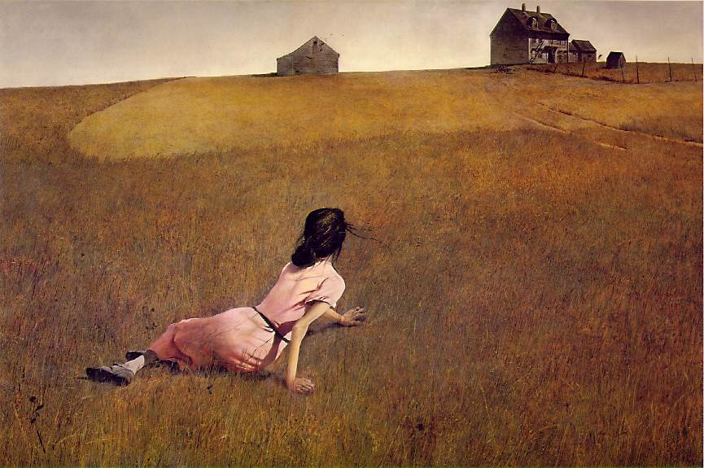
Christina’s World

Slide 2
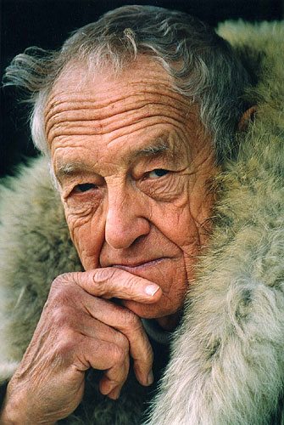
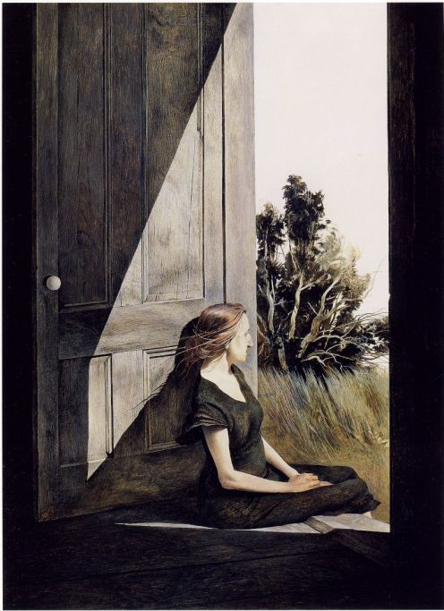
Christina's World is a 1948 painting by American painter Andrew Wyeth, and one of the best-known American paintings of the middle 20th century .It depicts a seemingly young woman lying on the ground in a treeless, mostly tawny field, looking up at and crawling towards a gray house on the horizon; a barn and various other small outbuildings are adjacent to the house.

Slide 3
Background
The woman of the painting is Christina Olson (May 3, 1893 - January 27, 1968). She had an undiagnosed muscular deterioration that paralyzed her lower body. Wyeth was inspired to create the painting when through a window from within the house he saw her crawling across a field. Wyeth had a summer home in the area and was on friendly terms with Olson, using her and her younger brother as the subject of paintings from 1940 to 1968. Although Olson was the inspiration and subject of the painting, she was not the primary model — Wyeth's wife Betsy posed as the torso of the painting. Although the woman in the painting appears young, Olson was 55 at the time Wyeth created the work.
The house depicted in the painting is known as the Olson House, and is located in Cushing, Maine. It is open to the public as a part of the Farnsworth Museum complex; it is on the U.S. National Register of Historic Places, and has been restored to match its appearance in the painting.[In the painting, Wyeth separated the house from its barn and changed the lay of the land.

Slide 5
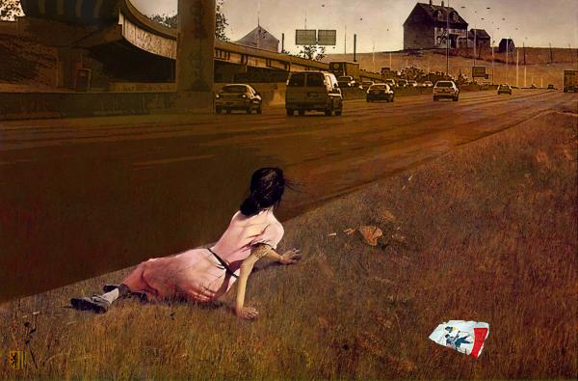

Slide 6
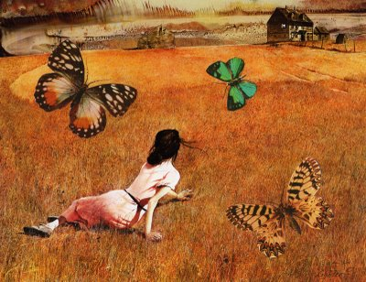

Slide 7
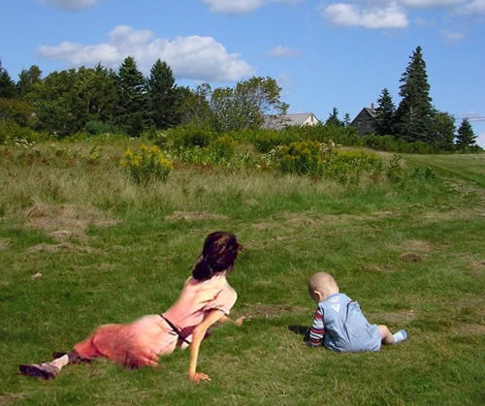

Slide 8
Who is in the painting?
What was wrong with her?
What inspired the painting?
How old was the woman in the painting?
Where is the house in the painting?

